Slide 1
Imaging of Neurofluids
Irene Vavasour
Dec 3, 2025
UBC MRI Research Centre Monthly Analysis Meeting

Slide 2

Land Acknowledgment
I would like to acknowledge that UBC’s Point Grey campus is situated on the traditional, ancestral and unceded territory of the Musqueam people.
To learn more about our indigenous communities visit
https://medicine.med.ubc.ca/indigenous-resources/

Slide 3
Neurofluids
all fluids in brain and spinal cord
arterial blood
venous blood
cerebrospinal fluid (CSF)
interstitial fluid (ISF)

Slide 4
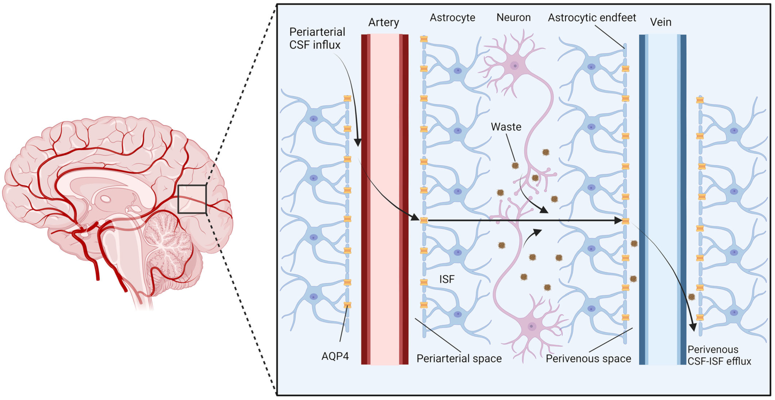
Glymphatic system
brain-wide neurofluid exchange network that facilitates waste clearance
Szlufik S. Cells 2024

Slide 5
Components of the Glymphatic System

Slide 6
Neurovasculature
prevents reductions in blood flow during drops in blood pressure
matches delivery of oxygen and glucose with brain energy requirements
contributes to clearance of metabolic waste generated by the brain
regulates bidirectional molecular exchange between blood and brain through transcytosis and molecular transporters
is involved in the trafficking of immune cells in and out of the brain
generates growth factors to maintain neurons and glia

Slide 7
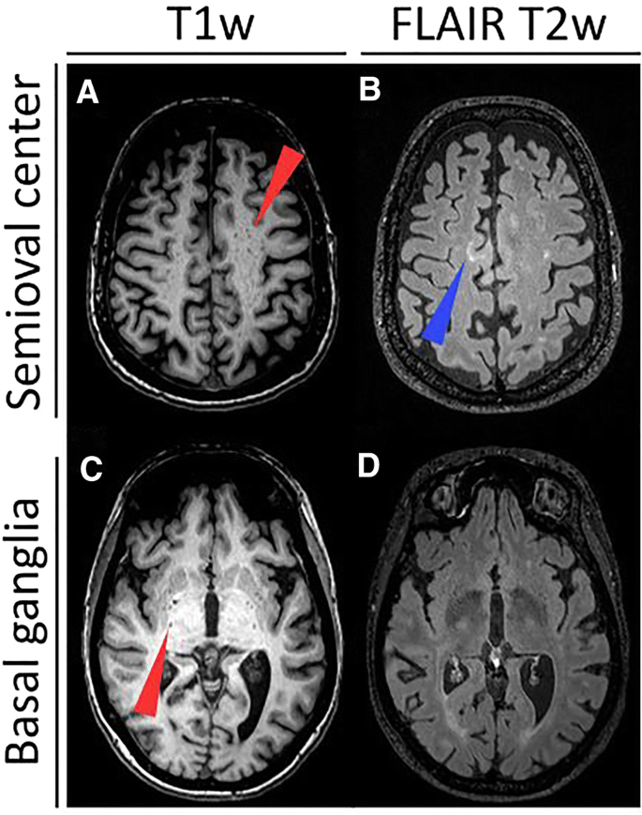
Perivascular Spaces
space between the outer aspect of an artery wall and the brain parenchyma
visible on MRI as small lines or dots of CSF signal <3 mm diameter in the subcortical gray and WM
best visualised on T2w
can show enlargement which is thought to indicate glymphatic dysfunction
much easier to see on 7T than 3T
Granberg, T. J Neurol 267, 3199–3212 (2020).

Slide 8
CSF and ISF
CSF
highly vascularised tissue located in ventricles that produces CSF
ISF
brings oxygen and nutrients to cells and clears away waste
The mixing of CSF and ISF in vital to the waste clearance function of the glymphatic system

Slide 9
CSF dynamics
flow of CSF into brain is caused by
constant pressure of production of new CSF
pulsation of the heart drives CSF into the periarterial spaces
CSF influx is increased during sleep
CSF movement is considered pseudorandom with a turbulent flow component and a molecular diffusion component

Slide 10
MRI in Neurofluids

Slide 11
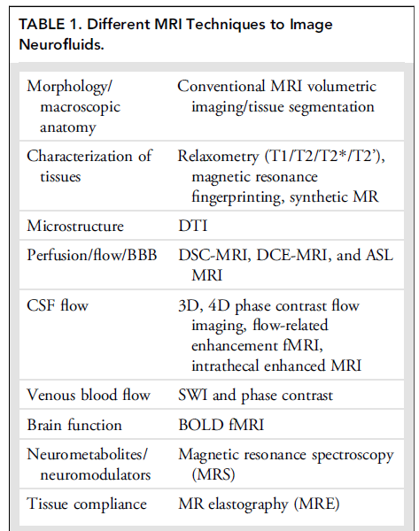
MRI methods to evaluate glymphatic system
Agarwal N JMRI 2024

Slide 12
Gadolinium Based Contrast Agent (Gold standard)
Intrathecal
First studies done on animals with injection of tracer and two photon laser microscopy¹
evaluates the pathway opposite to drainage of brain waste
difficult to use in deep white matter
not approved for use in humans
Intravenous
used to measure BBB leakage
can also enhance PVS
¹Iliff JJ. Sci Transl Med. 2012

Slide 13
Diffusion Tensor Imaging of Neurofluids
CSF > extracellular water > intracellular water
(~unrestricted) (intermediate) (restricted within the cell)
Low b-values (<500 s/mm²): signal sensitive to water movement in the tissue microstructure, including CSF along PVSs
Low to intermediate b-values: measure pseudorandom motion of CSF or capillary blood flow.
Intermediate b-values (~1000 s/mm²): provide insights into tissue structure and integrity (single-shell DTI and DTI-ALPS)
Very high b-values (>3000 s/mm²): sensitive to restricted diffusion within cellular structures

Slide 14
DTI methods
Intravoxel incoherent motion (IVIM)
broad range of b-values (emphasis on intermediate b)
DTI analysis along the perivascular space (DTI-ALPS)
relies on anatomical features of PVS at level of lateral ventricle
model multi-shell DTI into 3 components
diffusion, perfusion and intermediate flow reflecting CSF/ISF
low b-value DTI
sensitive to unrestricted fluid in large spaces like CSF

Slide 15
Intravoxel Incoherent Motion (IVIM)
a range of low to intermediate b-values has the potential to provide increased specificity
diffusion model that incorporates additional sources of dephasing beyond molecular diffusion, including incoherent flow such as that found in CSF
range of b-values and biexponential fit allows for the separation of a fast pseudo-diffusion and slow molecular diffusion compartment
signal from the fast compartment could have multiple sources including the microvasculature, CSF, or the ISF
Le Bihan D. Radiology. 1986

Slide 16
Free Water Fraction (FWF) Diffusion
initially proposed to disentangle the diffusion signal of extracellular free water from that of tissue compartments
single-shell protocols using a dual compartment model to estimate parenchymal FWF
using the same 2-compartment model but with a multi-shell acquisition gives more accurate measures
increased diffusivity measures in the morning compared to the evening driven by an increase in CSF/ISF-like FWF
linked to increased glymphatic function during sleep

Slide 17
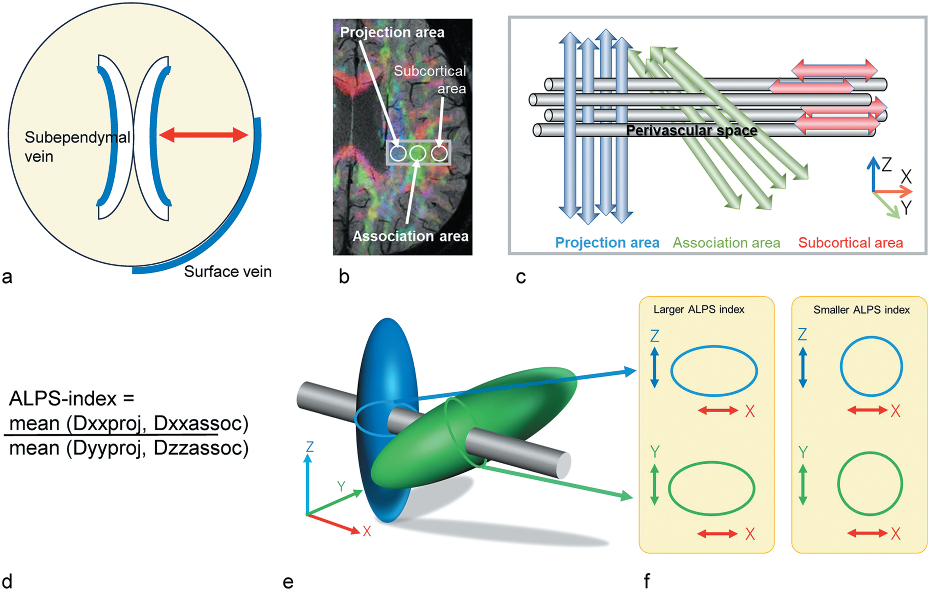
DTI aLong the Perivascular Space (DTI-ALPS)
Lee DA. Epilepsia Open. 2022

Slide 18
Diffusion Kurtosis Imaging
accounts for non-Gaussian diffusion within the tissue microenvironment
uses high b-values (>1500 s/mm²)
Changes in kurtosis may reflect alterations in the intracellular and extracellular environment caused by glymphatic function

Slide 19
Low b-value (<200–500 s/mm²)
sensitive to a combination of incoherent flow and molecular diffusion,
low b-value diffusion coefficient can detect the directional dependence of fluid movement in the PVS parallel to the direction of arterial blood flow
dependent on the cardiac cycle, with an increase of 300% measured during diastole
Two distinct CSF compartments found
lateral ventricles: pseudo random diffusion
3rd and 4th ventricles and sylvian fissure: linear or directional flow

Slide 20
low-b DTI
used to measure pseudorandom flow of CSF
Y Bito 2021 MRM

Slide 21
low-b DTI - acquisition
Diffusion-weighted echo-planar imaging:
TR = 10 s
TE = 90 ms
field of view = 240 mm (set to cover CSF at the top of head)
matrix = 128 x 128
slice thickness = 4 mm (interpolated to 2 mm)
number of slices = 30 (interpolated to 59).
diffusion gradients pulses: δ = 22.8 ms, Δ = 43.6 ms, diffusion time τ_{d} = 36.0 ms, and b = 0/100/1000 with 15 noncolinear directions
acquisition time = 5 min 10 s.
3T Hitachi scanner
Y Bito 2021 MRM

Slide 22
low-b DTI - analysis
2 tensors calculated
low b-value 0-100 (DT_{L})
high b-value 0-1000 (DT_{H})
calculate MD and FA
visually select ROI in CSF
high MD and FA
low MD and FA (free water reference)
Y Bito 2021 MRM

Slide 23
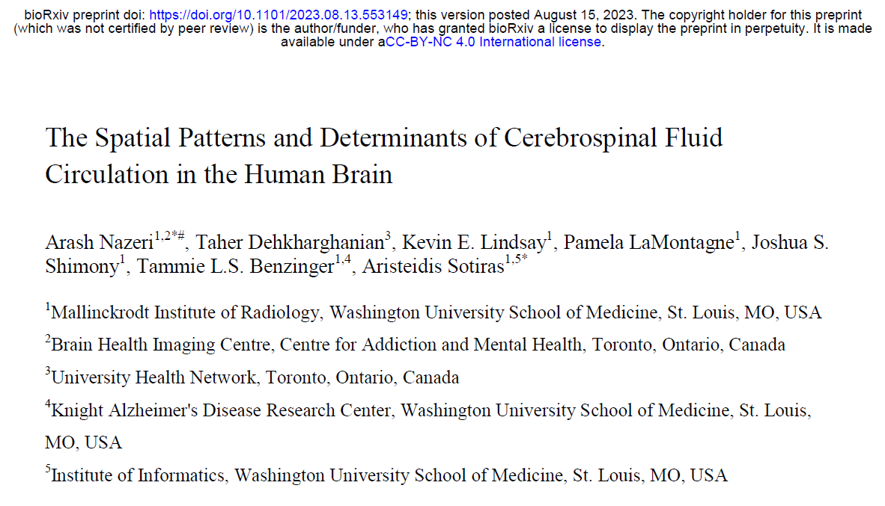
Details from a recommended manuscript

Slide 24
low-b DTI - dataset
OASIS-3
mix of controls and cognitively impaired participants
66 gradient directions
b-values
100 s/mm² (16 directions)
250 s/mm² (10 directions)
500 s/mm² (12 directions)
1,000 s/mm² (12 directions)
1,500 s/mm² (10 directions)
2,000 s/mm² (6 directions)
3 b0

Slide 25
low-b DTI - analysis
CSF pseudo-diffusion spatial statistics (CΨSS)
correction for Gibbs ringing - mrdegibbs (MRtrix3)
correction for eddy currents - eddy_correct (FSL)
Fit low b-value to the DTI model to extract CSF mean pseudo-diffusivity (MΨ)
also fit intermediate and high b-value
FA and MD images segmented into WM and CSF
used to create pseudo-T1w images
Atlases created of MΨ and pseudo-T1 (ANTs)

Slide 26
low-b DTI - analysis
Seed based correlation
ROIs defined
premedullary cistern,
cerebral aqueduct-4th ventricle
foramina of Monro,
right and left Sylvian fissure
Mean MΨ extracted
Voxel-wise Pearson’s correlations

Slide 27
low-b DTI - analysis
CSF Waterways (CWW)
Non-negative matrix factorization
identify CSF flow patterns where CSF MΨ covaries consistently among participants
Machine learning technique:
https://github.com/asotiras/brainparts

Slide 28
Questions and Discussion

Slide 29
Next Meeting
Wednesday, Feb 4th
Topic ?

